Slide 1


Slide 2


Slide 3



Slide 4




Slide 5
Interpreter

Slide 6
Interpreter
Compiler

Slide 7
Interpreter
Compiler
Just-in-time compilation

Slide 8

Interpreter
Compiler
Just-in-time compilation
WebAssembly

Slide 9

What is WebAssembly ?
levelupwasm.com/apps/asteroids

Slide 10
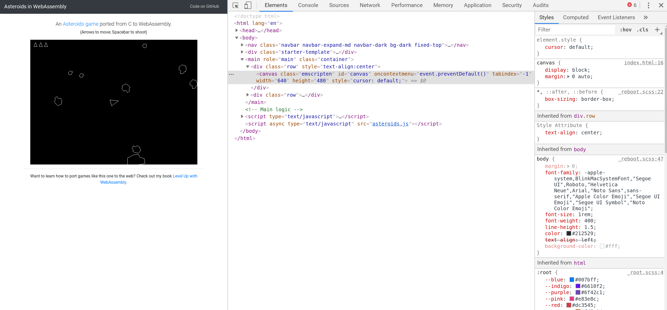
What is WebAssembly ?
Emscripten is the name of the compiler used to make WebAssembly code

Slide 11

What is WebAssembly ?
WebAssembly code
(also called Wasam)
transpiled (converted) from C to WebAssembly to run directly in the browser

Slide 12
Why is it important?

Slide 13

Why is it important?
Speed

Slide 14

Why is it important?
Speed
Figma 3X faster

Slide 15

Why is it important?
Speed
fastq.bio DNA sequencer 20X faster
Figma 3X faster

Slide 16

Why is it important?
Speed
Cloudflare Workers handle traffic close to end user location for fast response - now use WebAssembly
fastq.bio DNA sequencer 20X faster
Figma 3X faster

Slide 17

Why is it important?
Single code base

Slide 18

Why is it important?
Single code base
Pyodide: Python scientific on the browser

Slide 19


Why is it important?
Single code base
Pyodide: Python scientific on the browser
AutoCAD: web uses identical codebase as desktop

Slide 20
TL;DR

